Slide 1
Distilling effective supervision from severe label noise
Xiaoyu Li
2020.1.5

Slide 2
Background
Training deep neural networks usually requires large-scale labeled data.
Methods are proposed to learning from noisy label.
When noisy labels become prominent, deep neural networks inevitably overfit noisy labeled data.

Slide 3
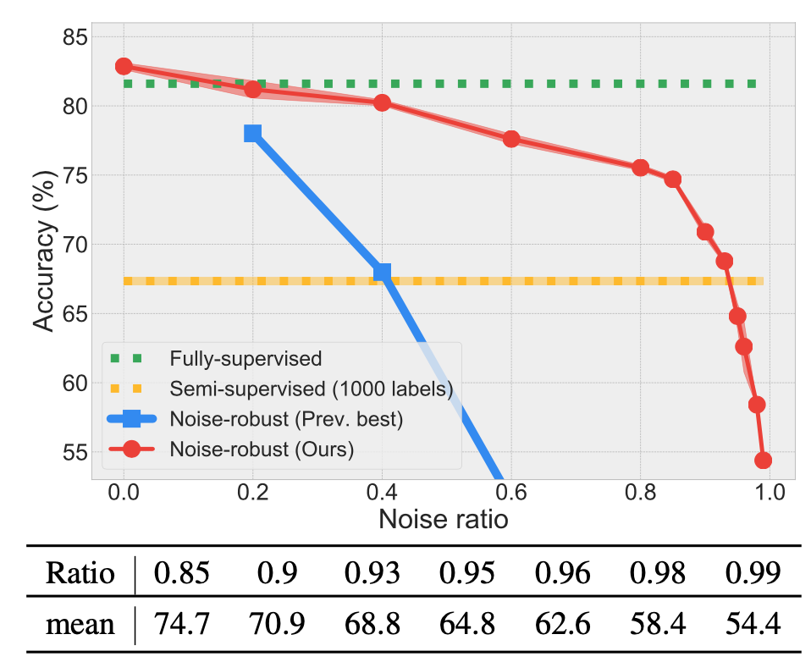
Motivation
To overcome this problem, we argue that
building the dataset wisely is necessary.
meta data + noisy data
Noise-robust training
VS
Semi-Supervised Learning
Should we discard noisy labels and opt in semi-supervised training at high noise regimes for model deployment?

Slide 4
Method
To wisely take advantage of a small trusted dataset to optimize exemplar weights and labels of mislabeled data in order to distill effective supervision from them for supervised training.
1. To incorporate conventional pseudo labeling into meta optimization.
2. To further utilize the probe data as anchors to reconstruct the entire noisy dataset using learned data weights and labels and thereby perform supervised training.

Slide 5
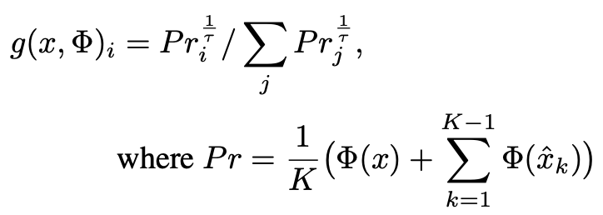
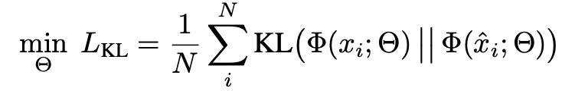
Method
Initial pseudo label estimator
averaging prediction over K augmentations
Improved pseudo label initialization
consistency on the predictions

Slide 6
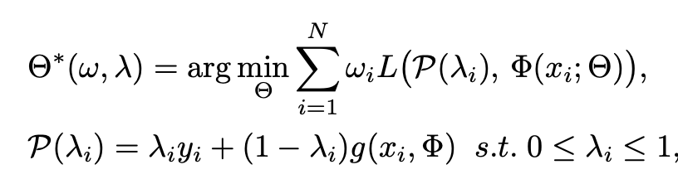
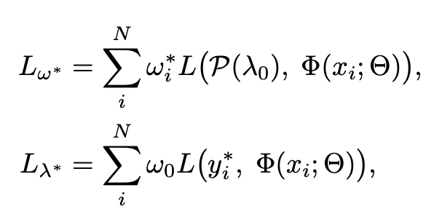
Method
Meta re-labeling

Slide 7
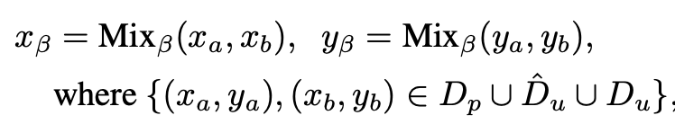
Method
Supervised training
possibly-mislabeled (which are assigned with pseudo labels) VS possibly-clean (which are assigned with original labels) using the binary criterion(ωi < T)

Slide 8
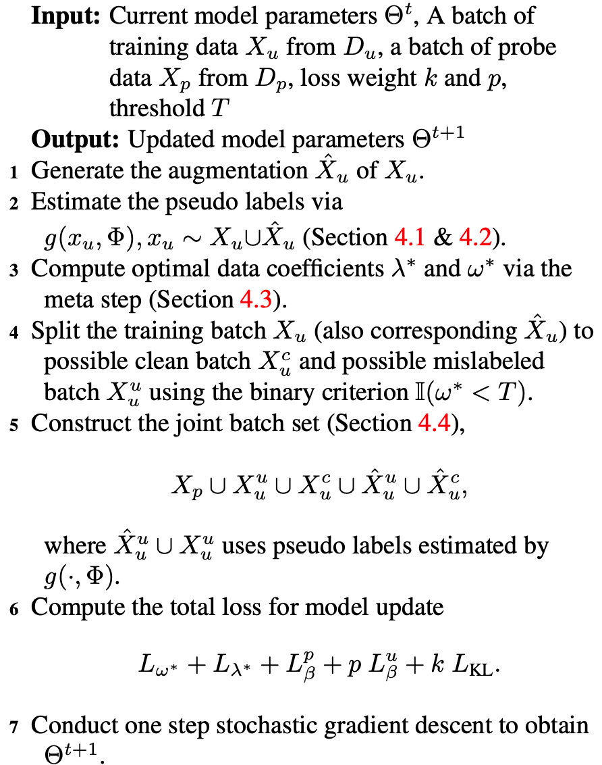
Method

Slide 9
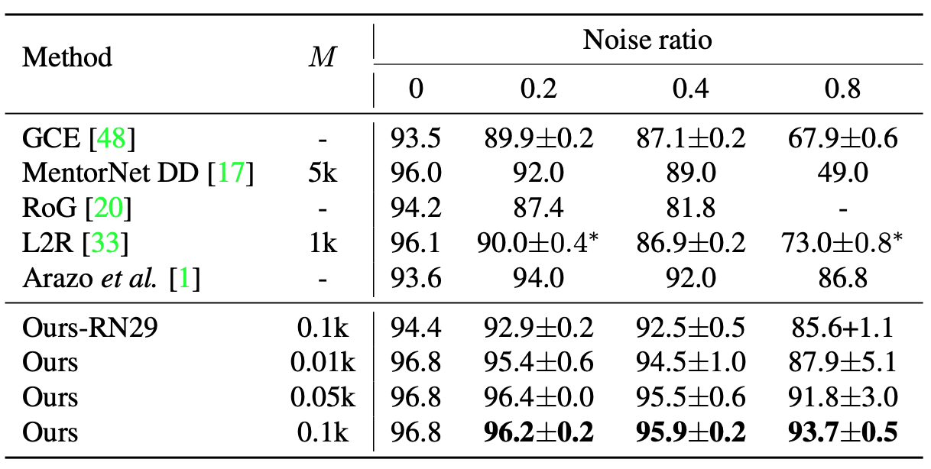
Experiments
Cifar 10 Uniform Noise

Slide 10
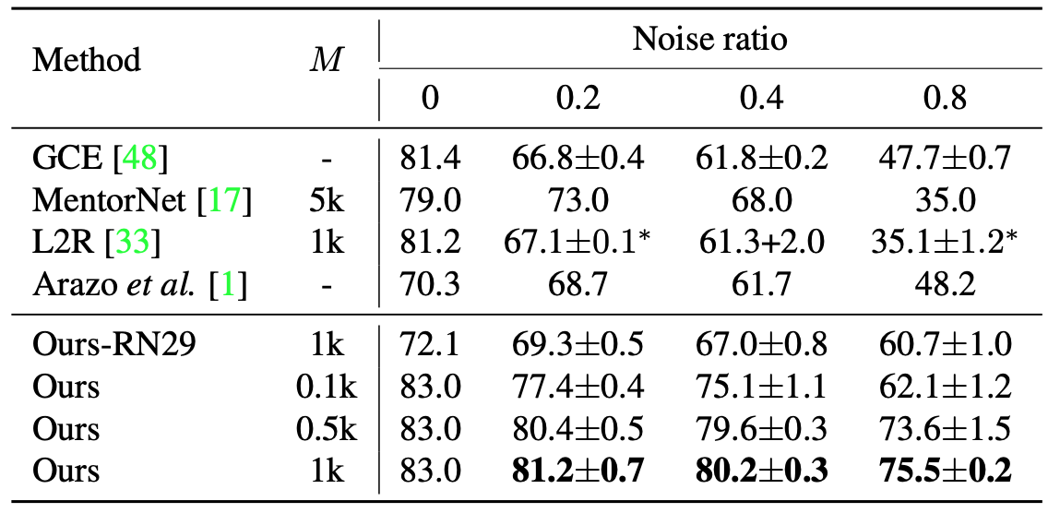
Experiments
Cifar 100 Uniform Noise

Slide 11
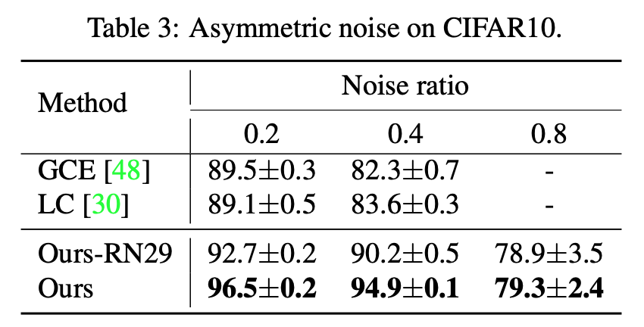
Experiments
Cifar 10 Flip Noise

Slide 12
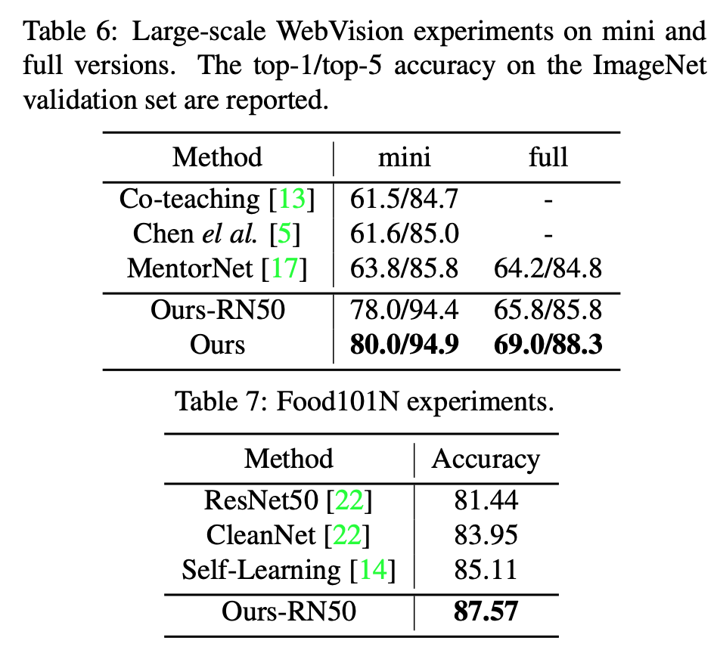
Experiment
“Our method achieves 77.21% on the Clothing1M dataset.”

Slide 13
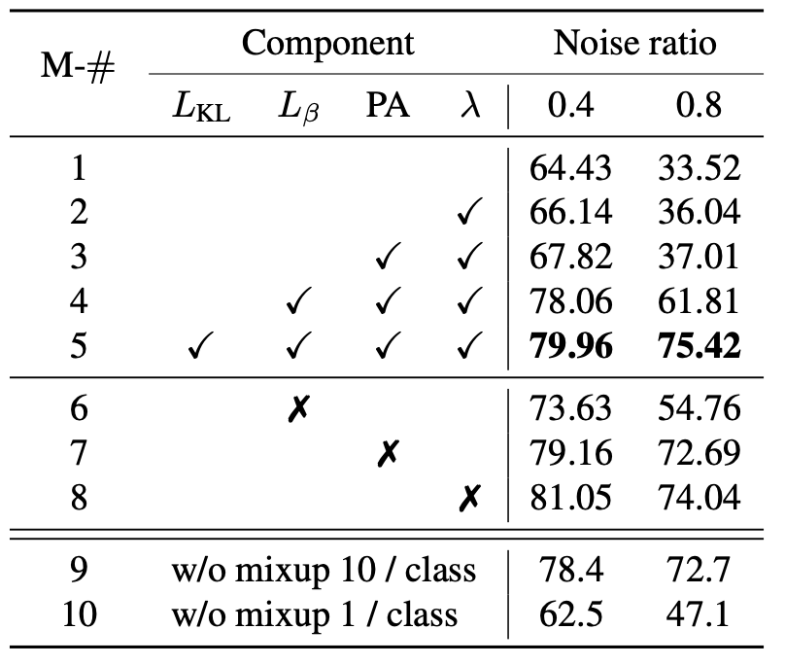
Experiments

